Slide 1
Agenda
Microservices with ASP.NET Core
Getting Started with Microservices
Building Microservices with ASP.NET Core
API Gateways
Ocelot API Gateway
Integrating Ocelot API Gateway
Testing Microservices Using Postman
Swagger
Web API Documentation with Swagger

Slide 2




Development Frameworks

Slide 3






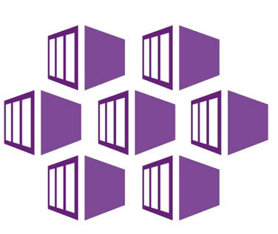



Tools For Building Microservices
Visual Studio
SQL Server
Postman App
Ocelot API Gateway
Swagger
RabbitMQ
Azure Subscription
MassTransit
Docker Desktop
Azure AKS

Slide 4
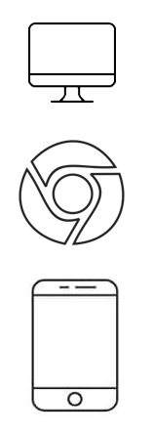



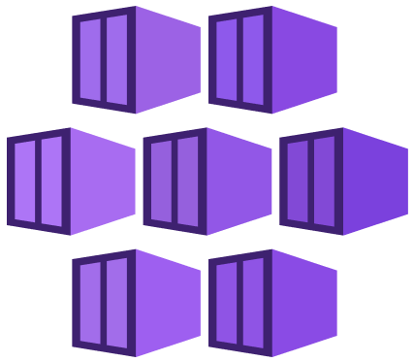
Microservices Project Architecture
Shopping Website
Auth Service
API Gateway
Catalog Service
Cart Service
Event Bus
End User
Internal Support Website
Order Service
Payment Service
Support Team
AKS Cluster
Stock Service
Frontend UIs

Slide 5
DEMO
Creating Backend Microservices

Slide 6

API Gateway
An API Gateway is a single point of entry for any microservice calls.
Work as a proxy service to route a request to the backend microservices.
Aggregate the results to send back to the consumer.
Offload the authentication/authorization responsibility of the microservice.
Catalog Microservice
API Gateway
Routing
Authentication Microservice
(Authentication,
response caching)
Order Microservice

Slide 7


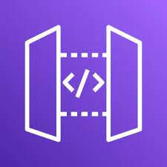
Microservices API Gateways
Ocelot API Gateway
NGINX Ingress Controller
Azure API Management
AWS API Management
Free: Open Source
Cloud Managed
Notes:
Compare NGINX Ingress Controller Models - NGINX

Slide 8
Ocelot API Gateway
An open-source API Gateway for the .NET Platform
Lightweight and run on the platform that supports ASP.NET Core
Provides all the necessary features of an API Gateway
Used by Microsoft itself for their projects

Slide 9
Ocelot API Gateway Features
Traffic Routing
Expose Unified endPoint
API Composition
Caching
Authentication
Authorization
Logging
Load balancing
Service Discovery

Slide 10
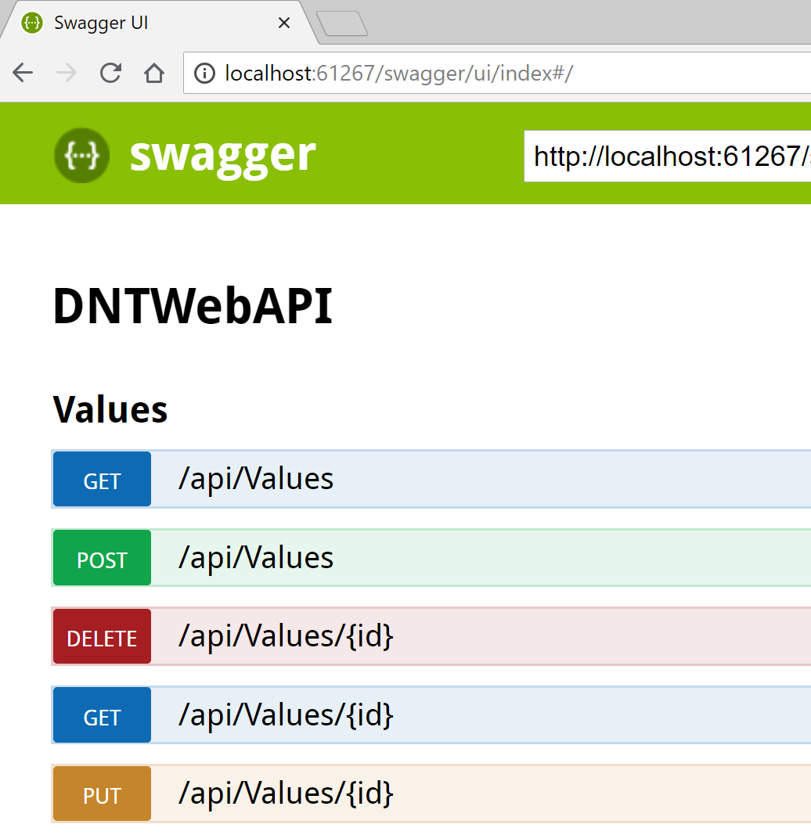
Swagger
Free and open-source framework
Define a standard, language-agnostic interface to a REST API
Help you to design, build, document, and consume REST APIs
Make API discovery easier

Slide 11
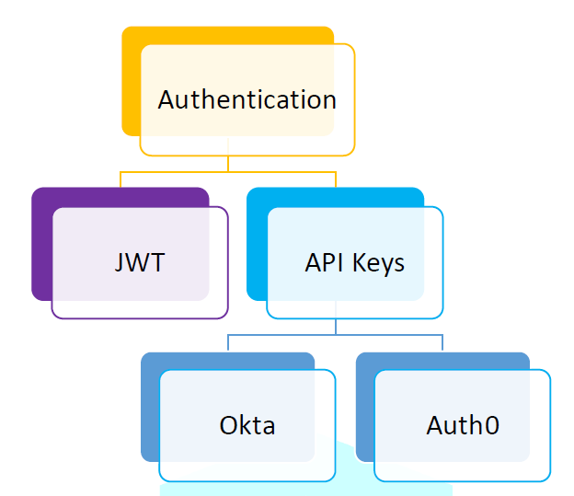
Token Based Authentication

Slide 12
What is IHttpClientFactory?
Introduced in .NET Core 2.1 and serves as a factory abstraction that can create HttpClient instances with custom configurations.
Provides a central location for naming and configuring logical HttpClient instances
Manages the pooling and lifetime of underlying HttpClient instances.
Adds a configurable logging experience (via ILogger ) for all requests sent through clients created by the factory.

Slide 13
Consumption Patterns
Basic usage: Register IHttpClientFactory by calling AddHttpClient() method and then requested using dependency injection (DI).
Named clients: Named clients are a good choice when: The app requires many distinct uses of HttpClient or Many HttpClients have different configuration.
Typed clients: Typed clients provide the same capabilities as named clients without the need to use strings as keys. Provides IntelliSense and compiler help when consuming clients. Provide a single location to configure and interact with a particular HttpClient.

Slide 14
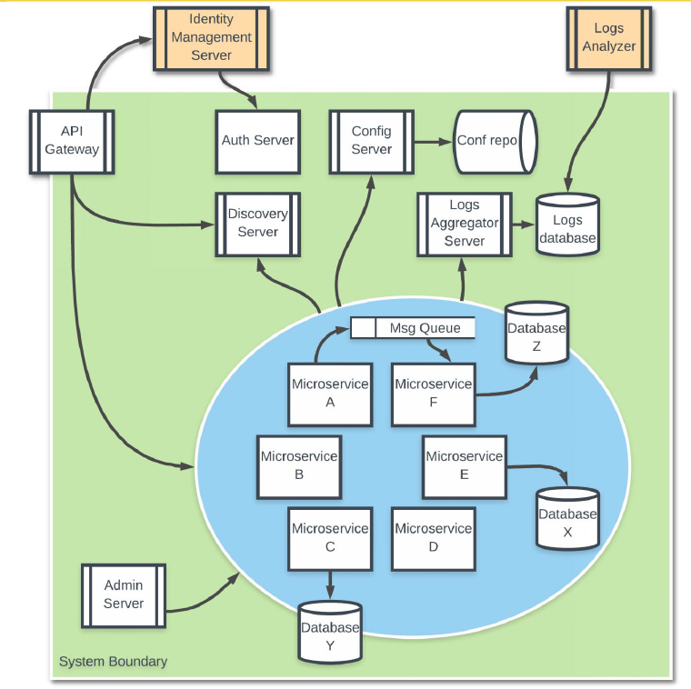
Components of a Microservice Architecture
Business Microservices
API Gateway
Discovery Server
Configuration Server
Identity Management Server
Authentication Server
Logs Aggregator Server
Logs Analyzer
Admin Server
Databases
Message Queues
Notes:
Identity Management Server - This will be an external system that has knowledge about the users, and their authentication process. It provides the auth token that can be use to identify user's session.
Authentication Server - It is usually implemented as a microservice, and provides login, logout, and refresh APIs. It can implement any standard or custom protocol for authentication, and session creation.
Load Balancer - These are third party systems. works as a reverse proxy and spread incoming requests on all the instances of a business microservice.
Reverse Proxy/Side Car - These are third party systems that are deployed before the microservice to assist it in many different ways like filtering, protecting, or monitoring content.
Log Aggregator - It is usually a third party service that captures all the logs streaming from the business microservices. It transform these logs into structure records, and store them in a database.
Admin Server - It is can be an external server or a custom build one. It takes performance metrics from all the business microservices, and have them display in a single dashboard. It can also generate compressed logs, reports and analytical data.

